Slide 1
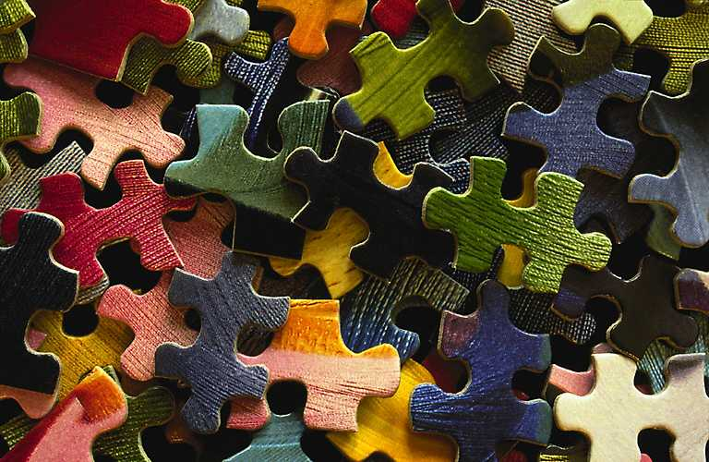
Puzzler
Scott Cai, Netta Gneezy,
Eric Richardson, Ethan Russell
https://www.romanpichler.com/wp-content/uploads/2013/11/jigsaw-puzzle-pieces.jpg
Notes:
Image Source: https://www.romanpichler.com/wp-content/uploads/2013/11/jigsaw-puzzle-pieces.jpg

Slide 2
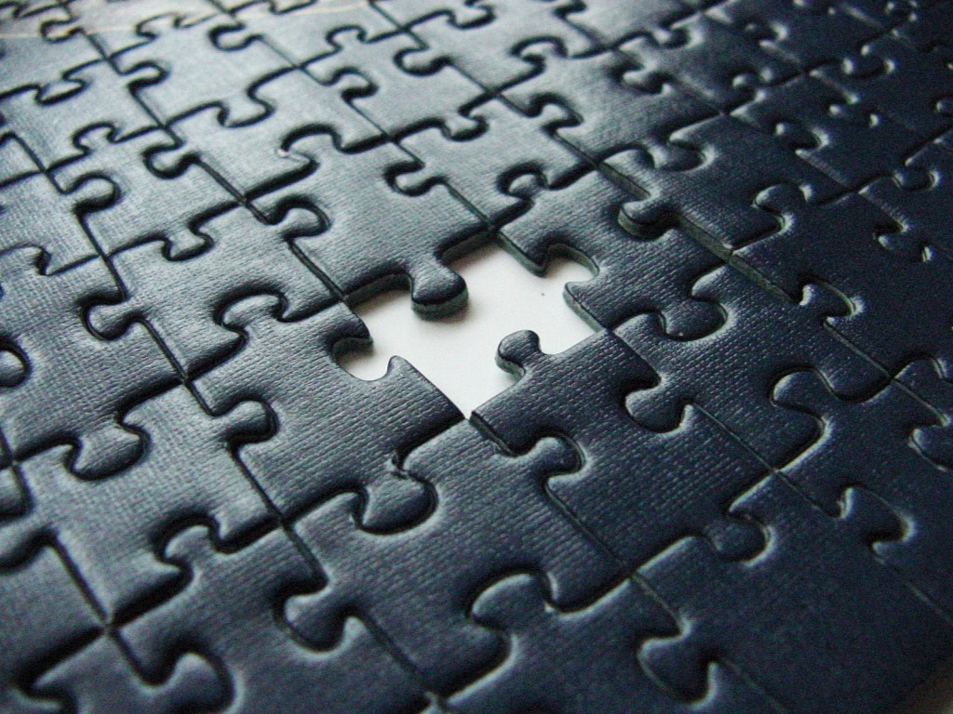
Motivation
Puzzles take a very long time to complete
Checking for missing pieces
Solution for ambiguous pieces
Broken object reconstruction
Notes:
Image Source: http://www.radicallychristian.com/wp-content/uploads/2013/04/puzzle-1024x768.jpg

Slide 3
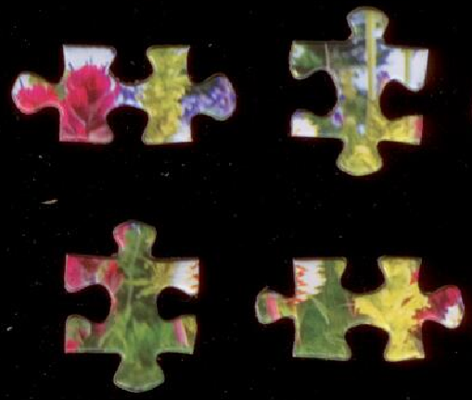
Assumptions
Pieces have 4 sides and 4 corners
Each side will be either, concave, convex, or straight
Pieces can be at any orientation

Slide 4
Approach
Generate Mask
Find and Characterize Pieces
Extract Features of Edge Combinations
Image of Puzzle Pieces
Visually Combine Puzzle Pieces
Determine Optimal Puzzle Solution
Find Probability using SVM
Solved Puzzle Image

Slide 5
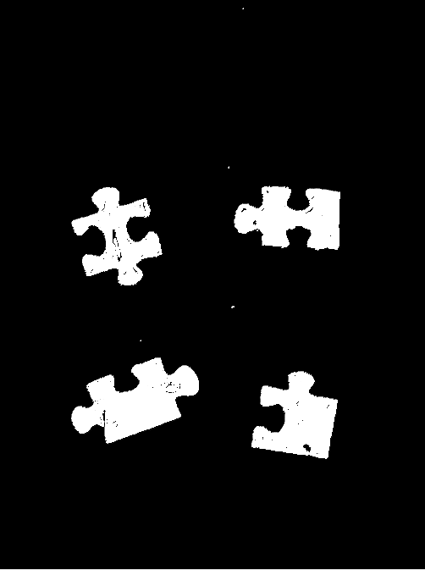
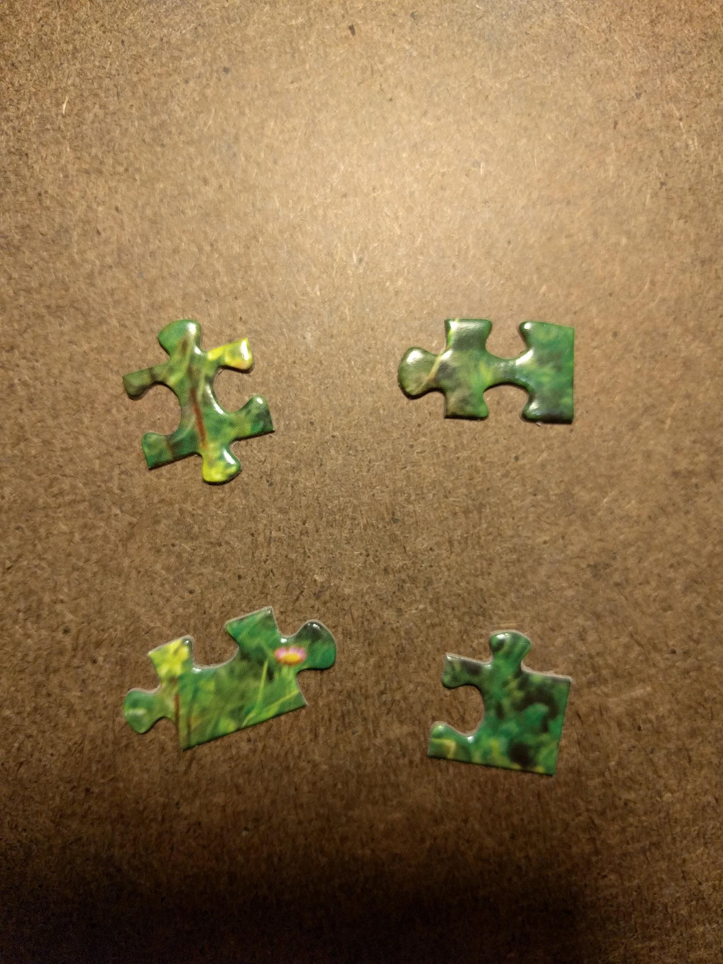
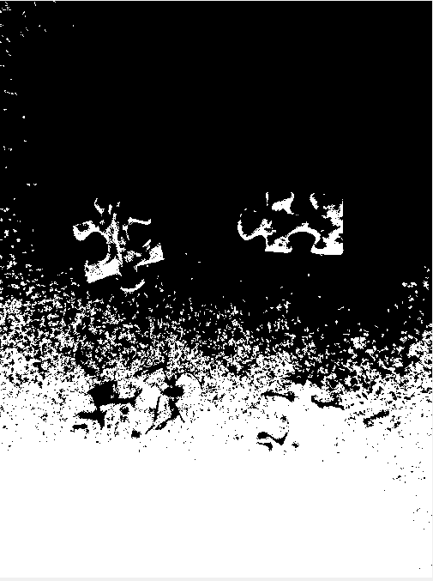
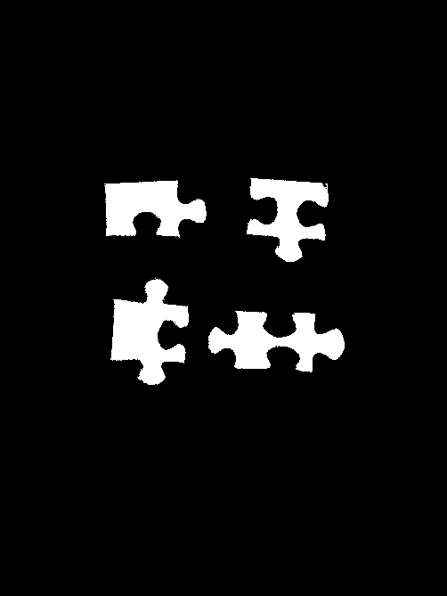
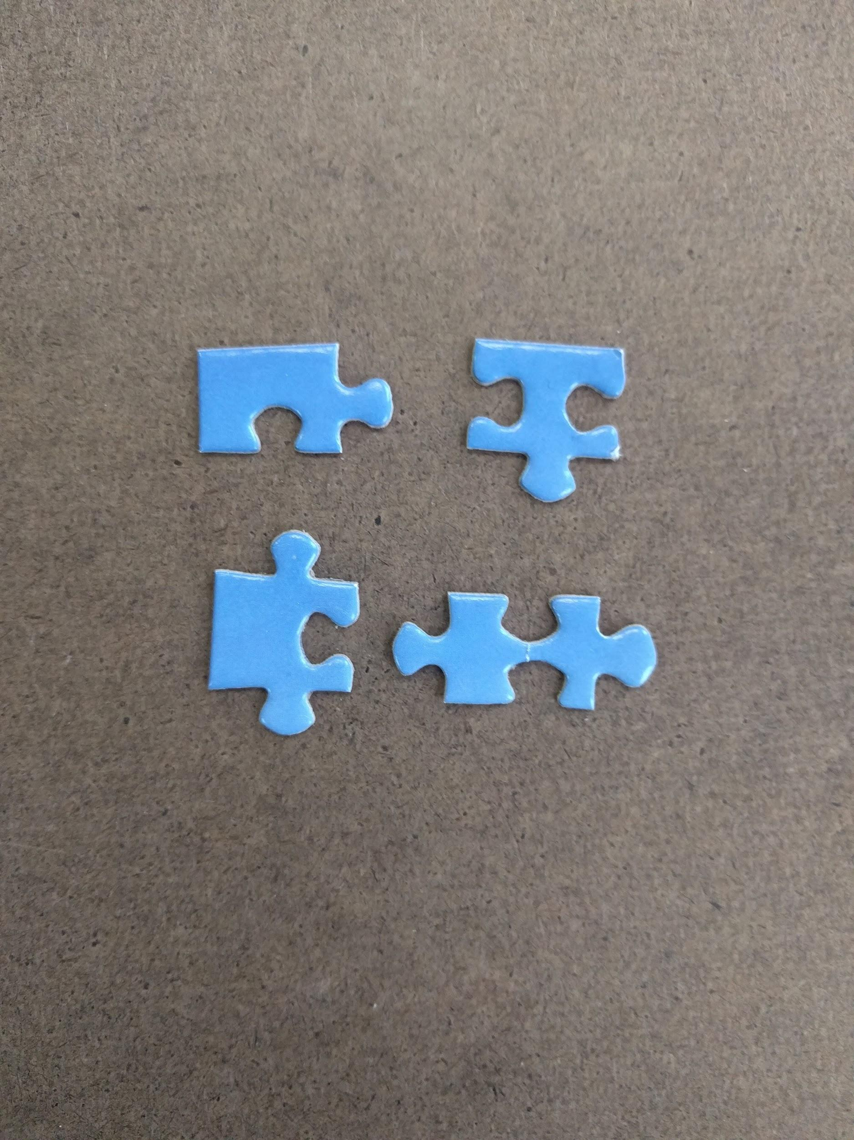
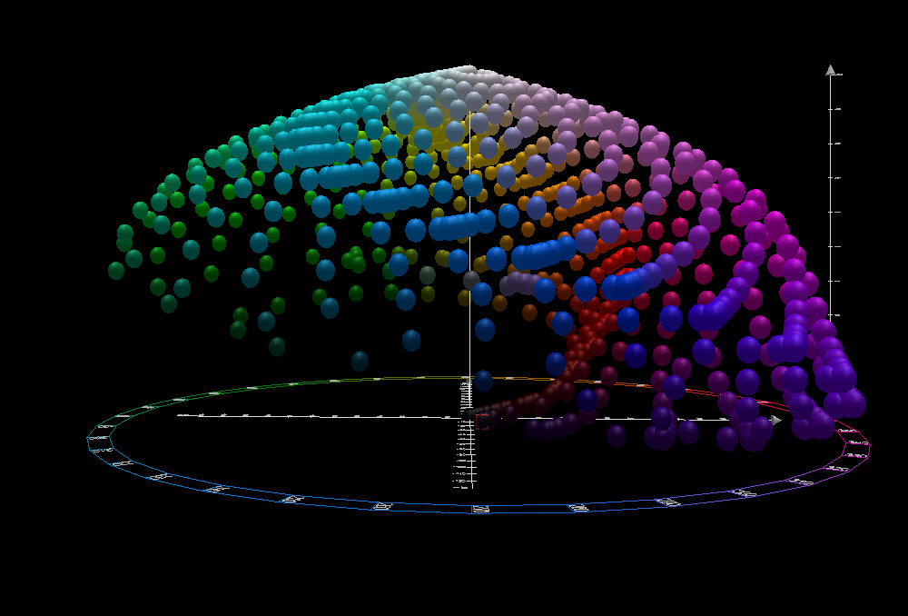
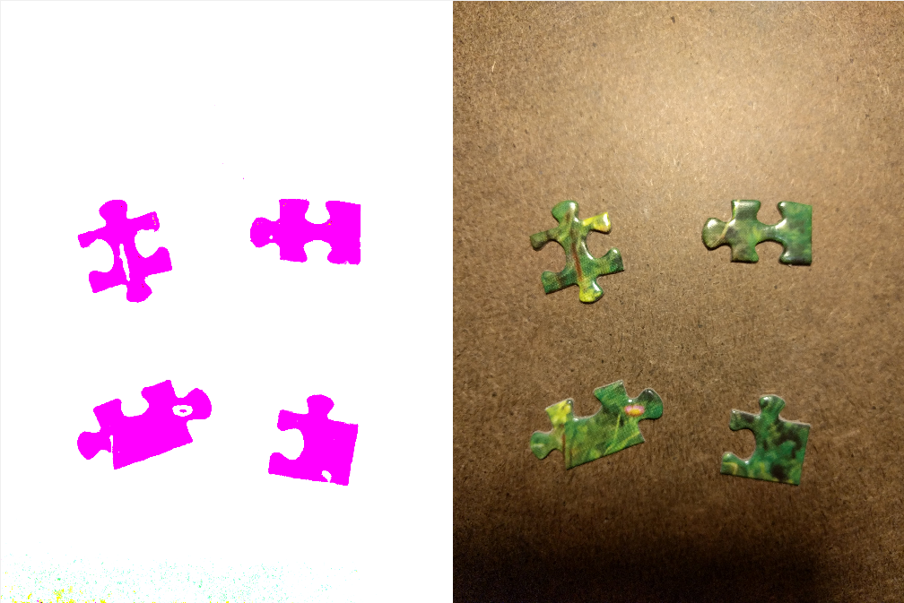
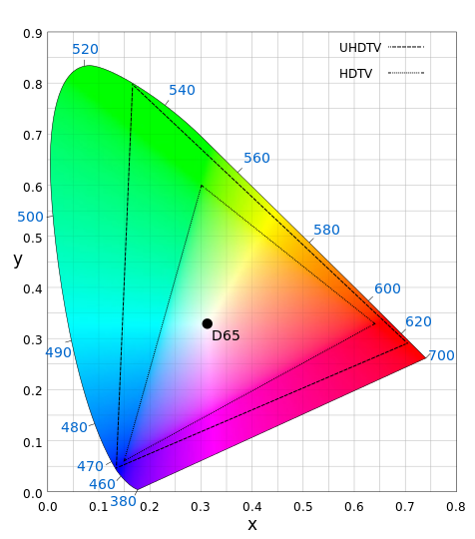
Images of Puzzle Pieces
Remove background on corners
K-mean clusters
Edge detector
Downsample noises
Color spaces: RGB, HSV, LAB, YCbCr

Slide 6
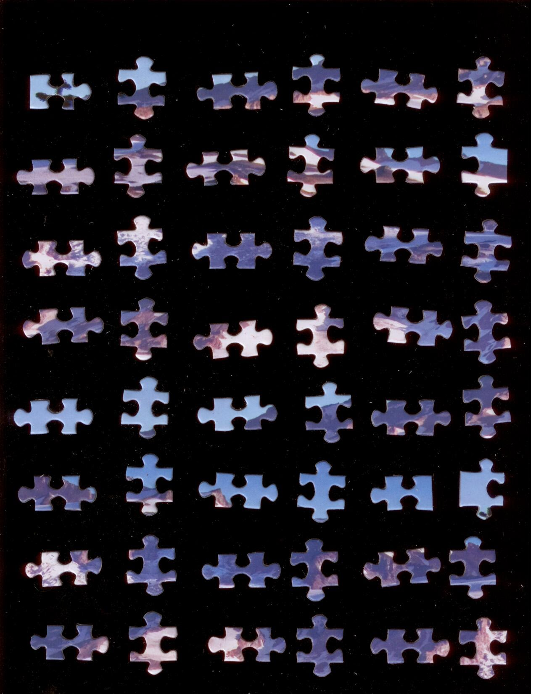
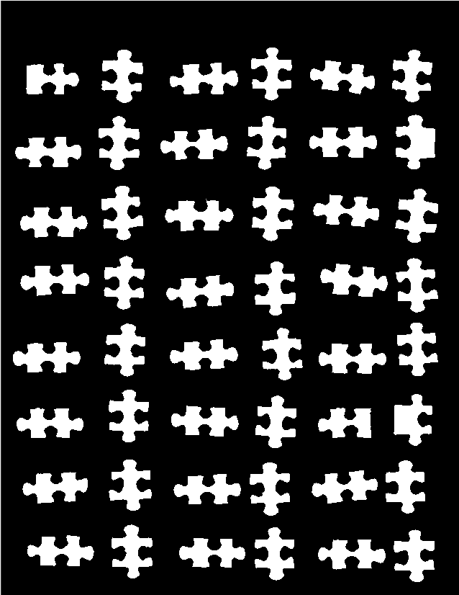
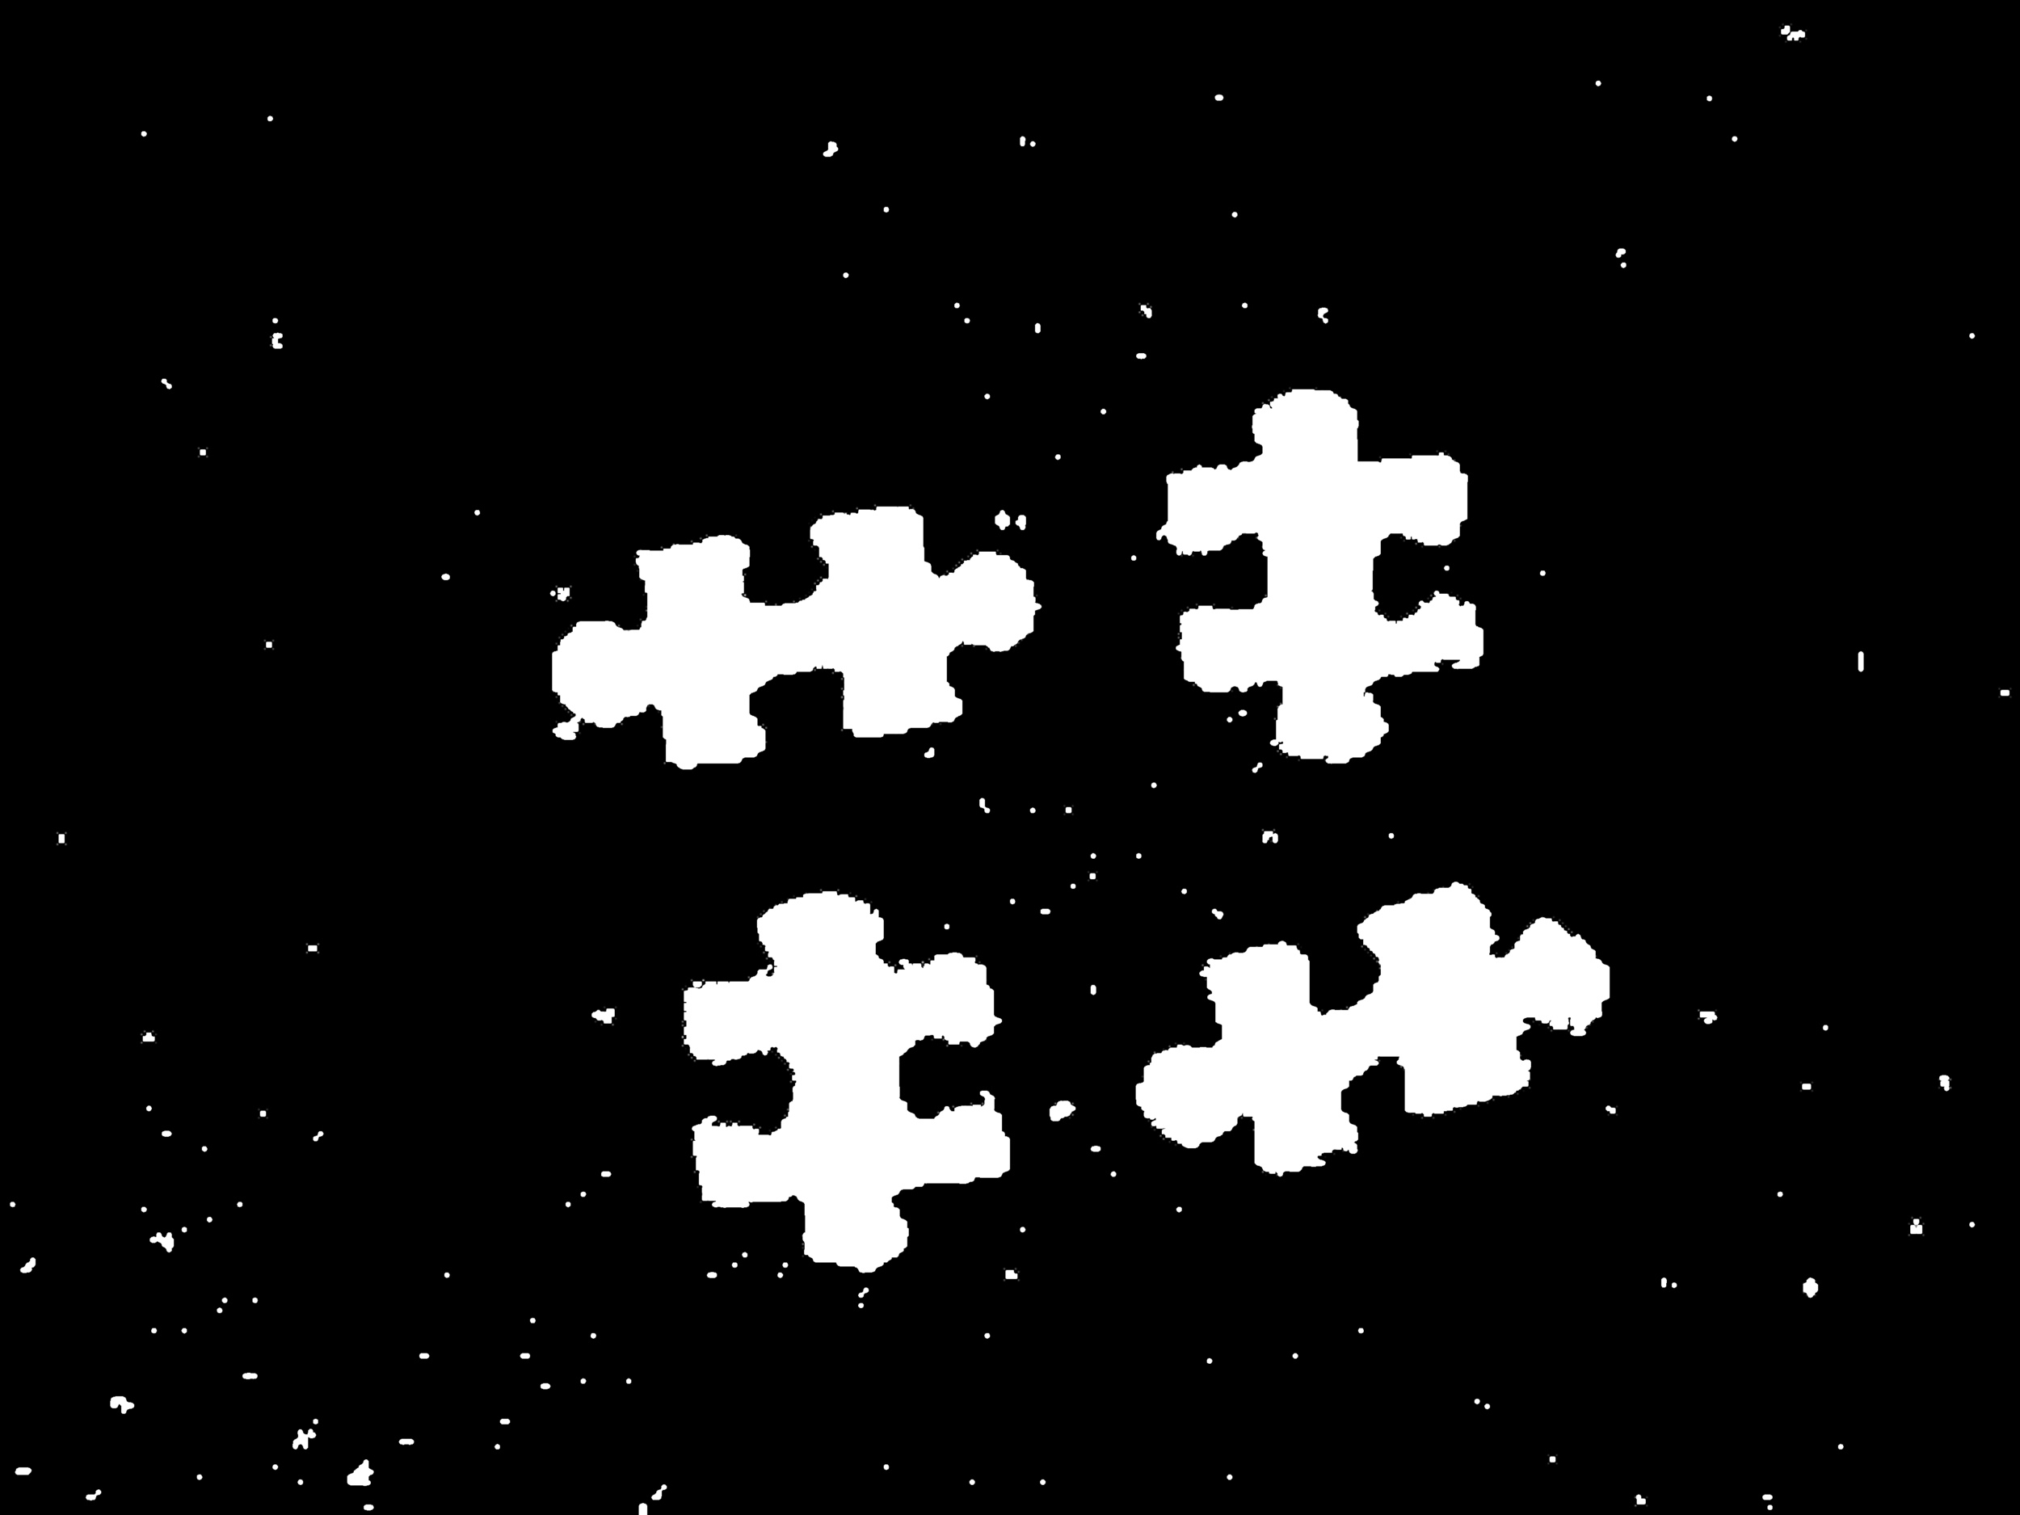
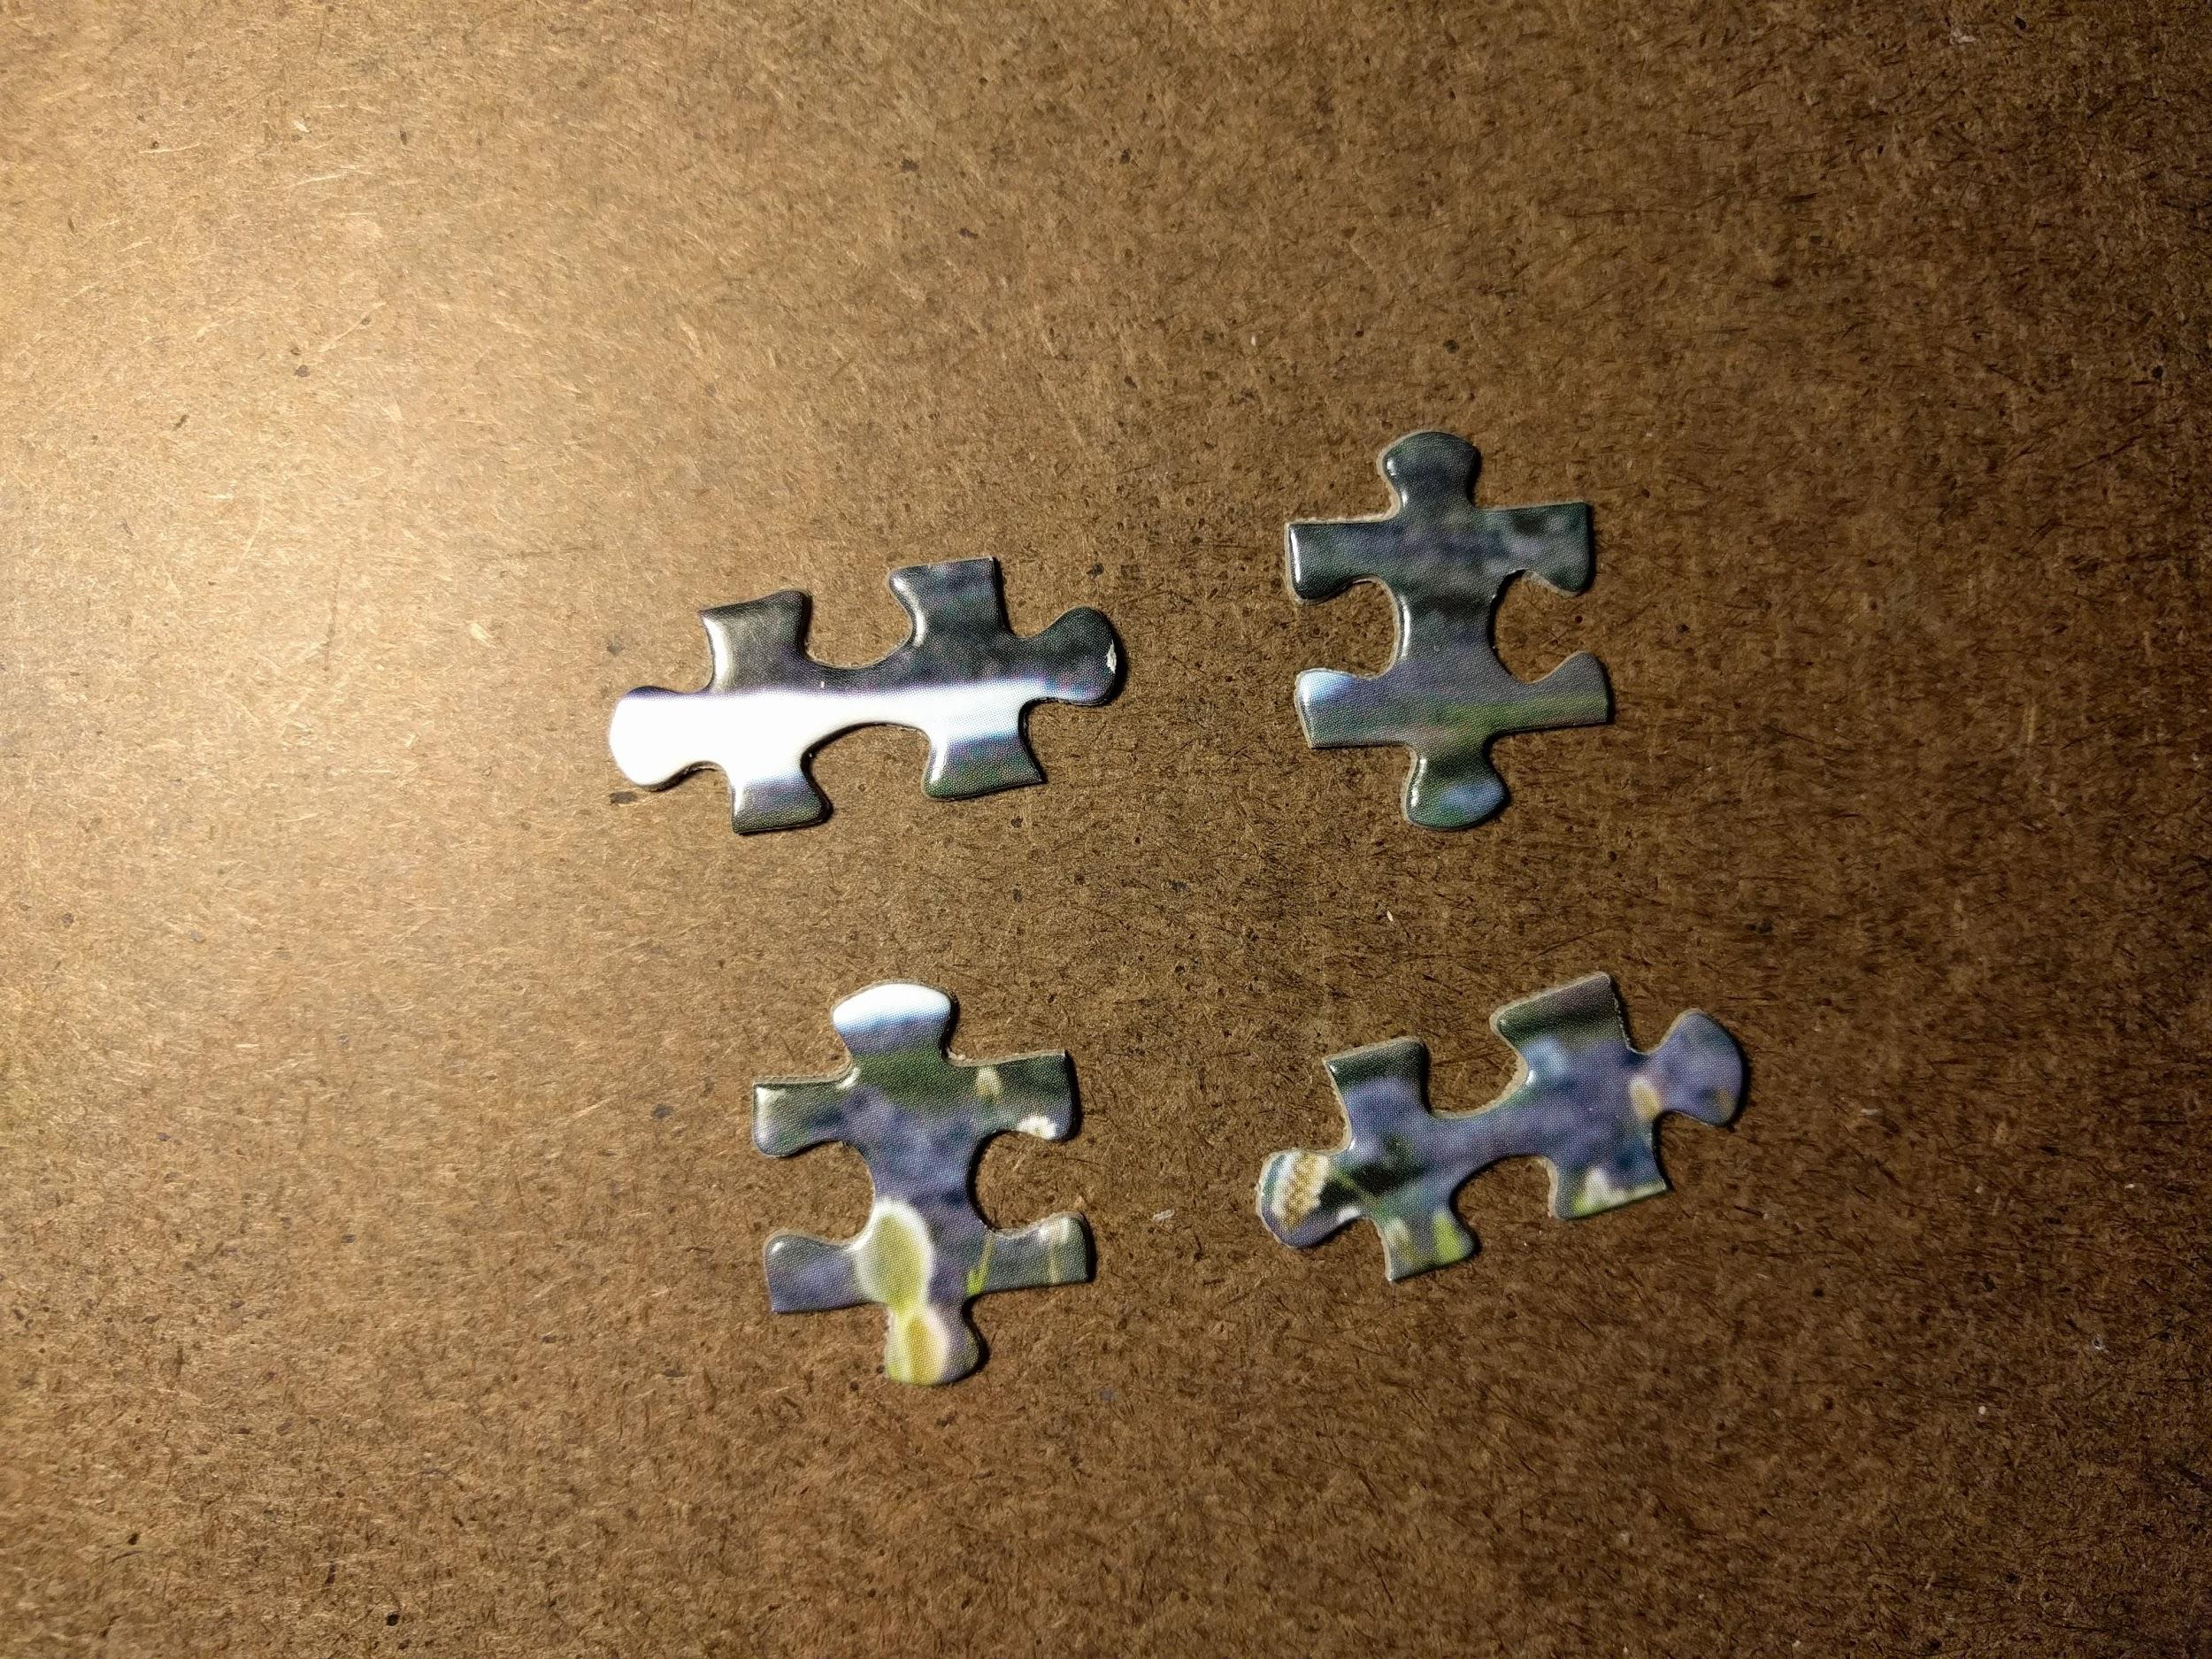
Photo VS Scanner

Slide 7
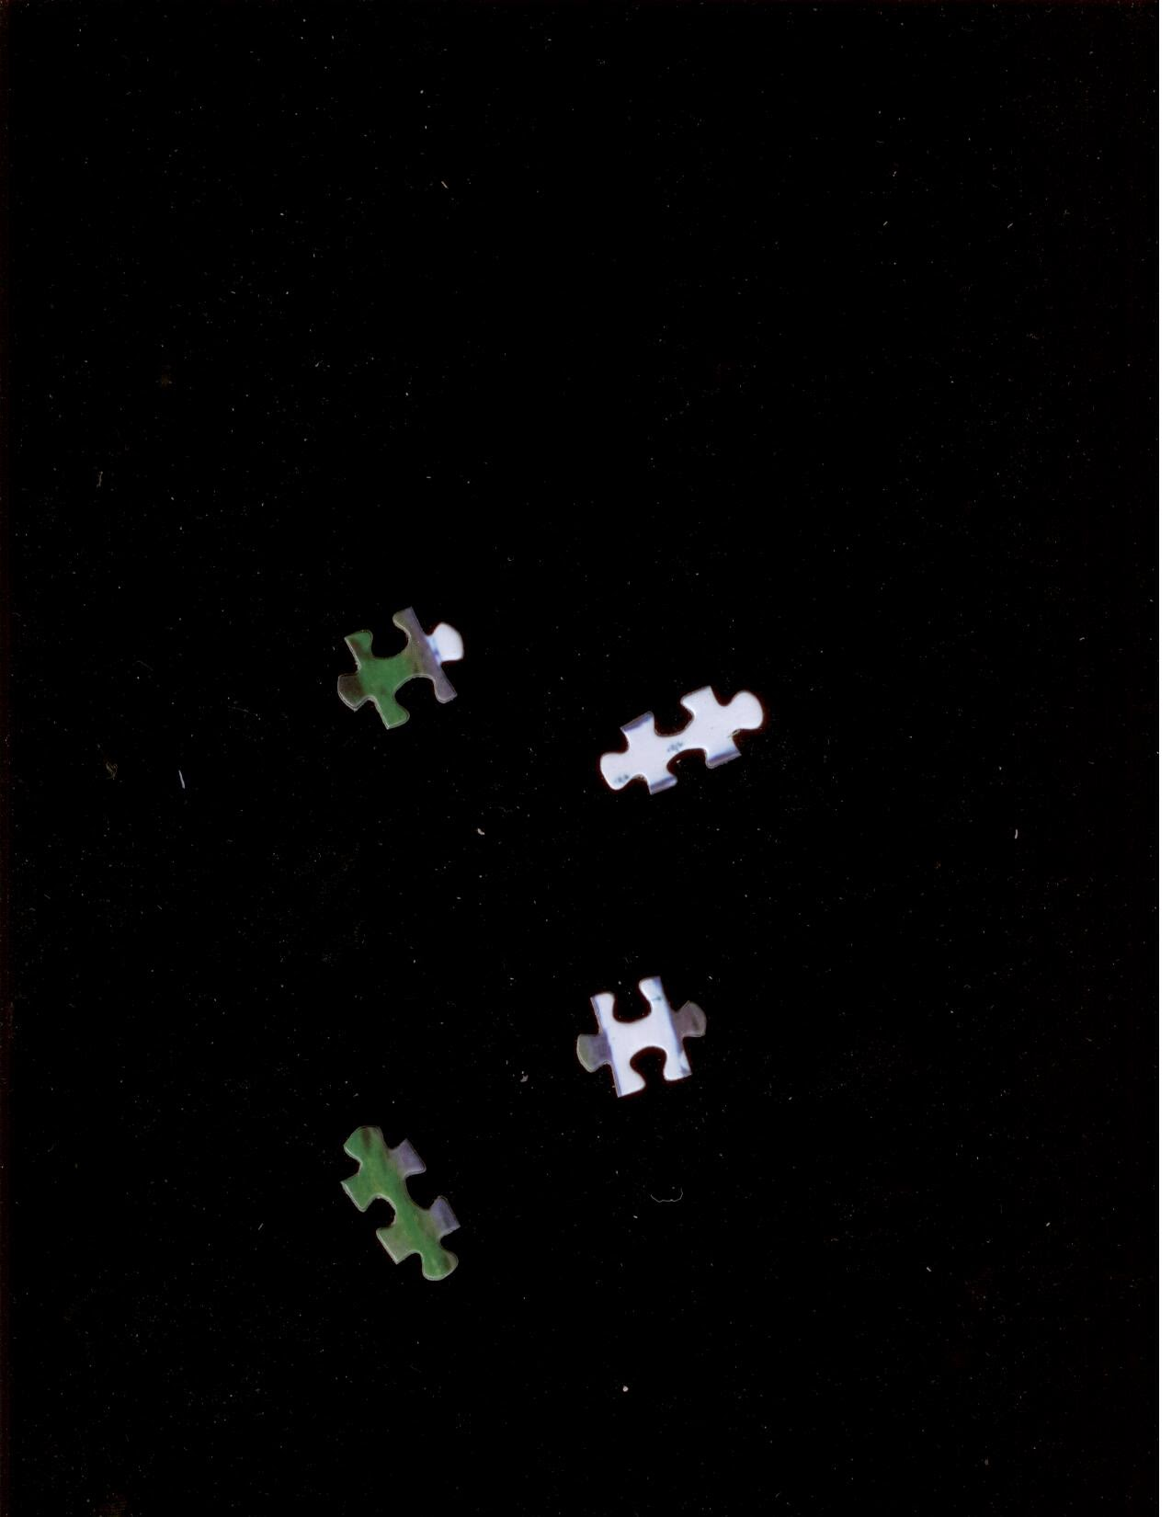
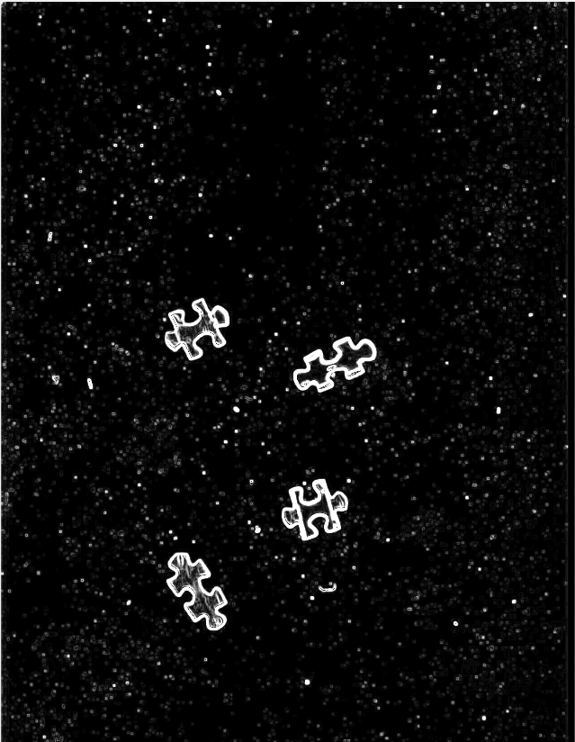
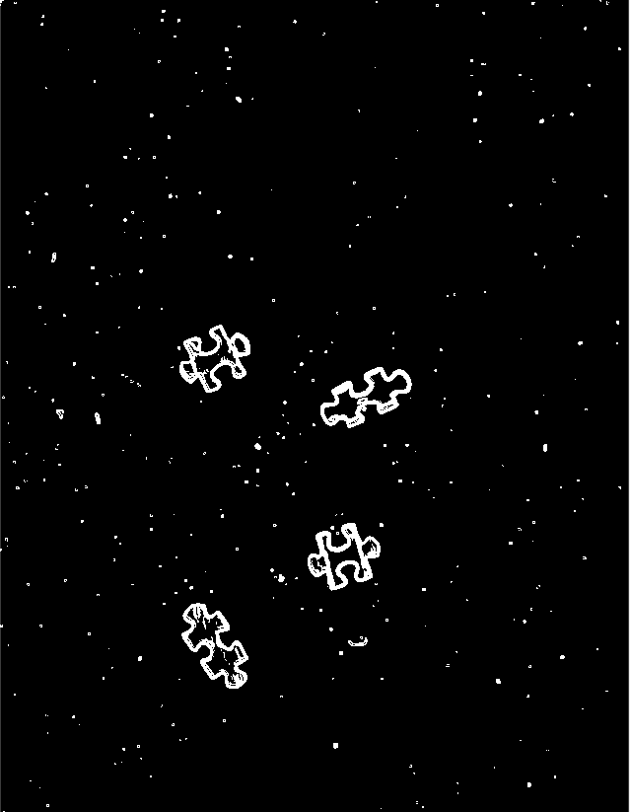
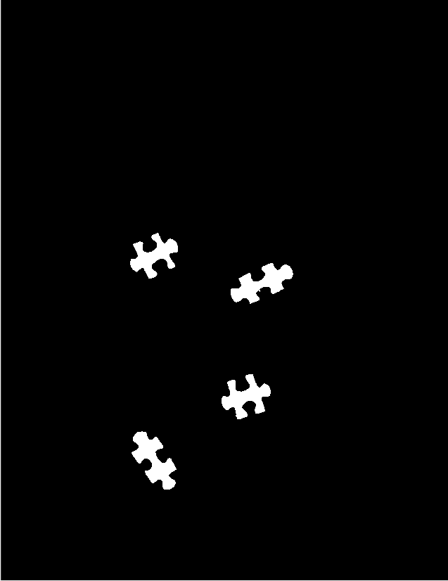
Mask Generation
Get gradient using gaussian edge filter
Threshold the gradient to get mask
Clean edges with morphology
Image
Mask

Slide 8
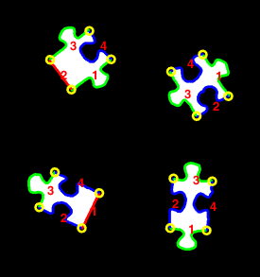
Find and Characterize Pieces
Find Location of Each Corner
Determine the type of each side
These properties will be used for feature extraction

Slide 9
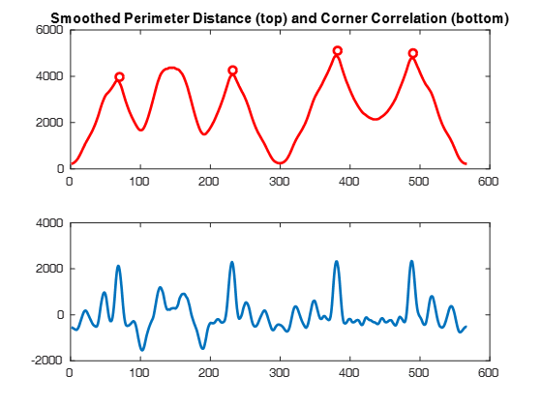

Corner Detection
Find distance from perimeter to centroid of the piece
Use 1D correlation with a “perfect” corner filter
Find places along perimeter with highest peaks in correlation

Slide 10
Side Classification
Side has peak in distance between corners?
Perimeter >> distance between corners?
No
Yes
Yes
No
Convex Edge
Concave Edge
Straight Edge

Slide 11
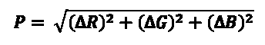
Extract Features - Color
Divides a side into three sections
Finds the mean of each section
Calculates the RGB distance between corresponding sections

Slide 12
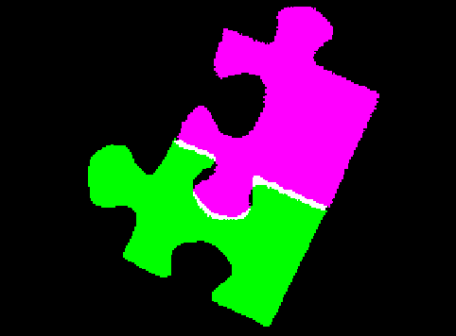
Extract Features - Shape
Rotate and translate pieces
Connects pieces using corners
Highlights overlapping pixels
Checks for Convex-Concave
Finds percentage of non-overlap pixels of smallest piece

Slide 13
SVM Training
Generated feature vectors and true classes for training, validation, and test sets
Trained the SVM using training set
Tuned Hyperparameters using validation set
Achieved 82.7% TPR, and 18.3% FPR on test set
Features
SVM
Score

Slide 14
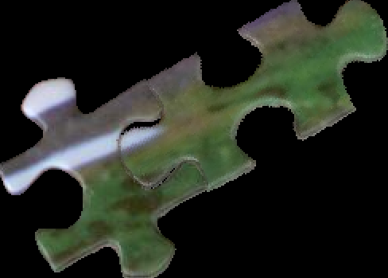
Solving the Puzzle
Generate matrix of scores for every possible edge match
Current solution for matching 2 pieces
Compare scores for each puzzle piece
Iteratively find the best score for each piece
Backtracking to avoid incomplete solutions

Slide 15
Demonstration

Slide 16
Challenges & Lessons Learned
Photos are too variable
Feature extraction for every possible edge match is extremely costly
This project turned into half image recognition, half algorithms

Slide 17
Future Work
Improving/adding additional features to reduce run-time and improve SVM accuracy
Getting a complete solution for a 2x2 puzzle
Expanding the solver to work with larger puzzles

Slide 18
Questions/Comments?

